Slide 1

Ethical and Legal Aspects of Computer Security
Notes:
The legal and ethical aspects of computer security encompass a broad range of
topics, and a full discussion is well beyond the scope of this book. In this chapter, we
touch on a few important topics in this area.
The bulk of this book examines technical approaches to the detection, prevention,
and recovery from computer and network attacks. Chapters 16 and 17 examine
physical and human-factor approaches, respectively, to strengthening computer
security. All of these measures can significantly enhance computer security but
cannot guarantee complete success in detection and prevention. One other tool is
the deterrent factor of law enforcement. Many types of computer attacks can be
considered crimes and, as such, carry criminal sanctions. This section begins with a
classification of types of computer crime and then looks at some of the unique law
enforcement challenges of dealing with computer crime.

Slide 2
Computer Crime/Cybercrime
“Computer crime, or cybercrime, is a term used broadly to describe criminal activity in which computers or computer networks are a tool, a target, or a place of criminal activity.”
Notes:
Computer crime , or cybercrime , is a term used broadly to describe criminal activity
in which computers or computer networks are a tool, a target, or a place of criminal
activity. These categories are not exclusive, and many activities can be characterized
as falling in one or more categories. The term cybercrime has a connotation of
the use of networks specifically, whereas computer crime may or may not involve
networks.

Slide 3
Types of Computer Crime
the U.S. Department of Justice categorizes computer crime based on the role that the computer plays in the criminal activity:
computers as targets
involves an attack on data integrity, system integrity, data confidentiality, privacy, or availability
computers as storage devices
using the computer to store stolen password lists, credit card or calling card numbers, proprietary corporate information, pornographic image files, or pirated commercial software
computers as communications tools
crimes that are committed online, such as fraud, gambling, child pornography, and the illegal sale of prescription drugs, controlled substances, alcohol, or guns
Notes:
The U.S. Department of Justice [DOJ00] categorizes computer crime based
on the role that the computer plays in the criminal activity, as follows:
• Computers as targets: This form of crime targets a computer system, to
acquire information stored on that computer system, to control the target
system without authorization or payment (theft of service), or to alter the
integrity of data or interfere with the availability of the computer or server.
Using the terminology of Chapter 1 , this form of crime involves an attack on
data integrity, system integrity, data confidentiality, privacy, or availability.
• Computers as storage devices: Computers can be used to further unlawful
activity by using a computer or a computer device as a passive storage medium.
For example, the computer can be used to store stolen password lists, credit
card or calling card numbers, proprietary corporate information, pornographic
image files, or “warez” (pirated commercial software).
• Computers as communications tools: Many of the crimes falling within this
category are simply traditional crimes that are committed online. Examples
include the illegal sale of prescription drugs, controlled substances, alcohol,
and guns; fraud; gambling; and child pornography.

Slide 4
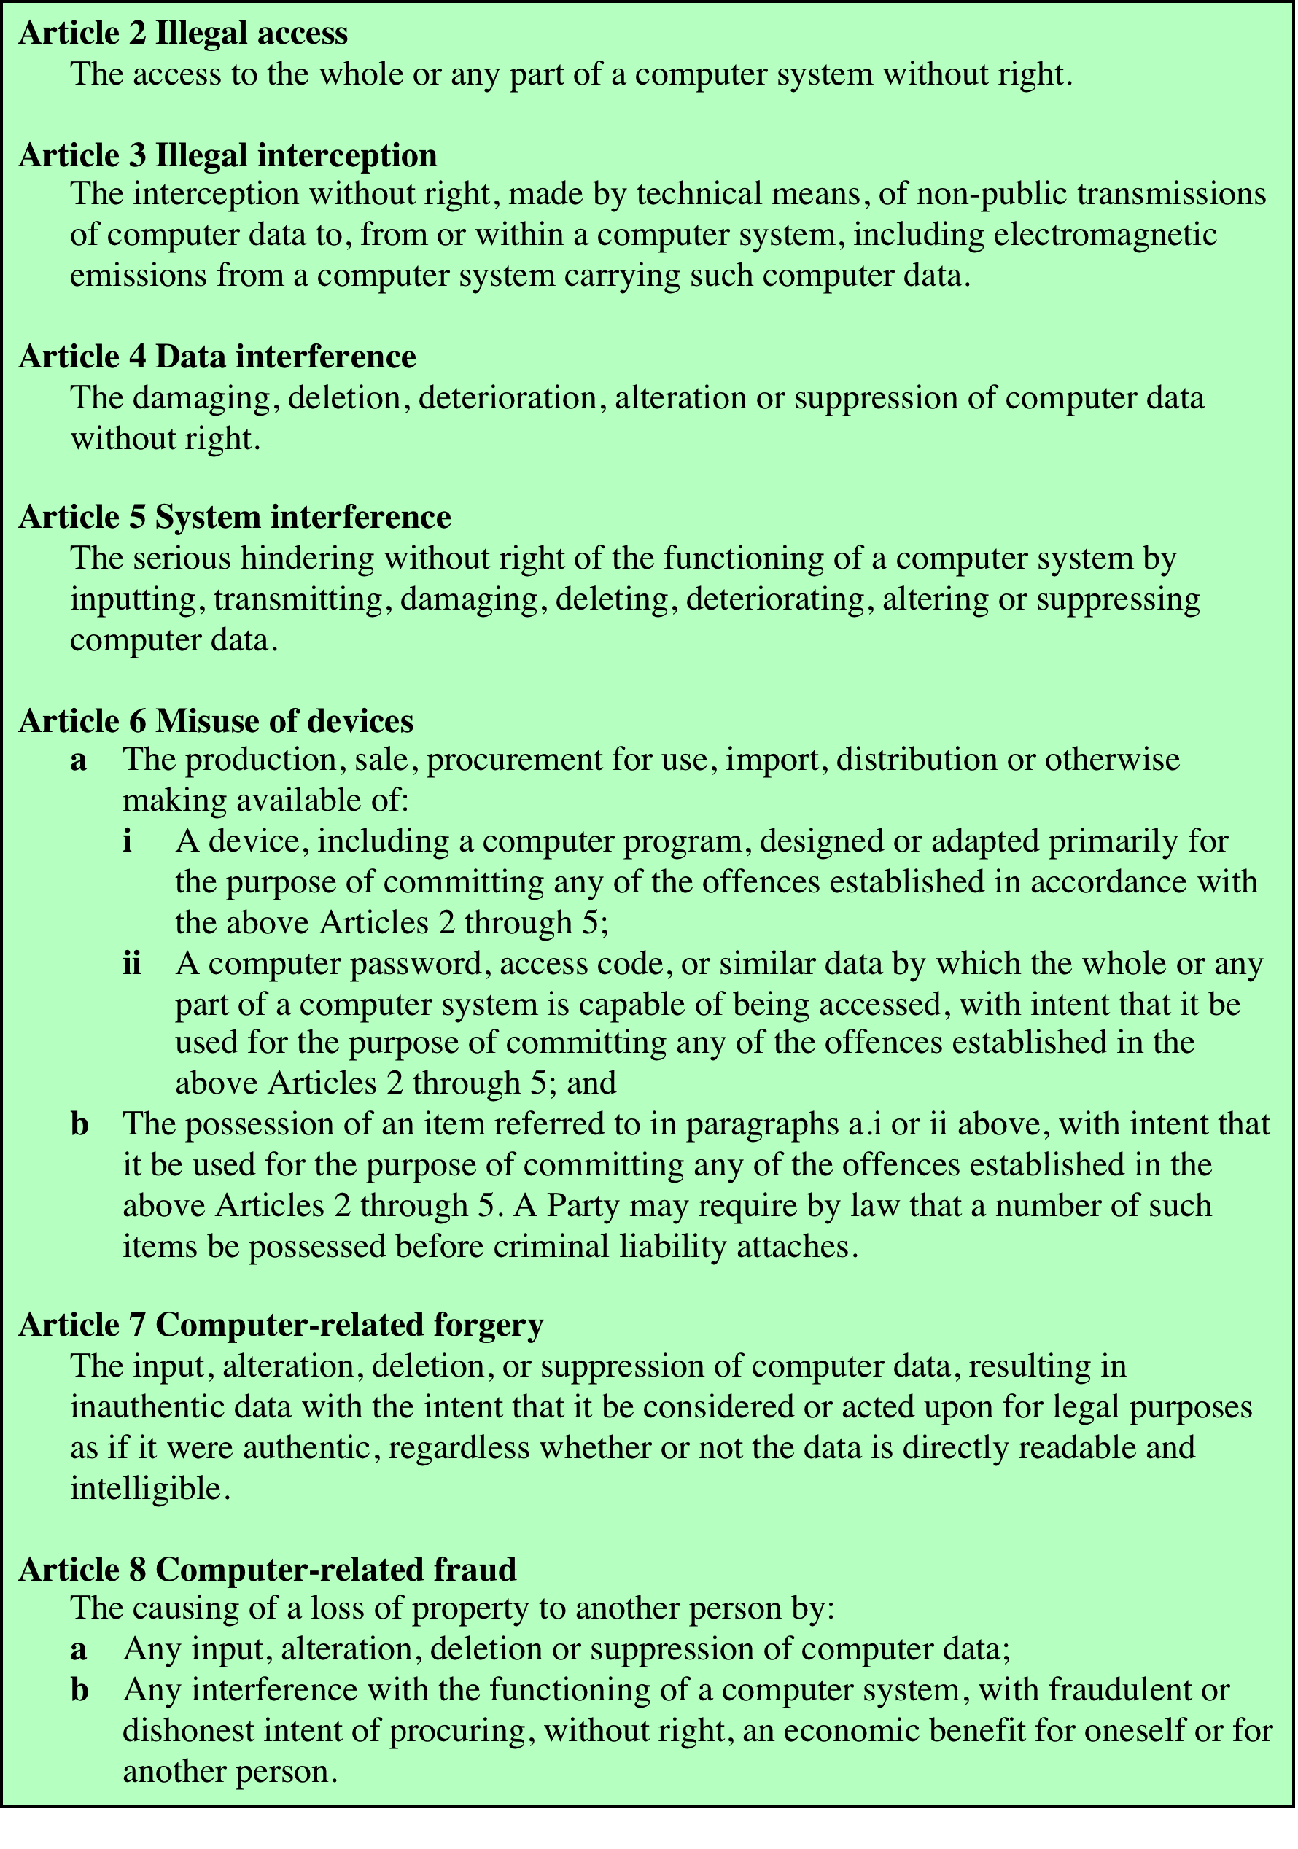
Table 19.1 Cybercrimes Cited in the Convention on Cybercrime (page 1 of 2)
Notes:
A more specific list of crimes, shown in Table 19.1 , is defined in the
international Convention on Cybercrime. This is a useful list because it represents
an international consensus on what constitutes computer crime, or cybercrime, and
what crimes are considered important.

Slide 5
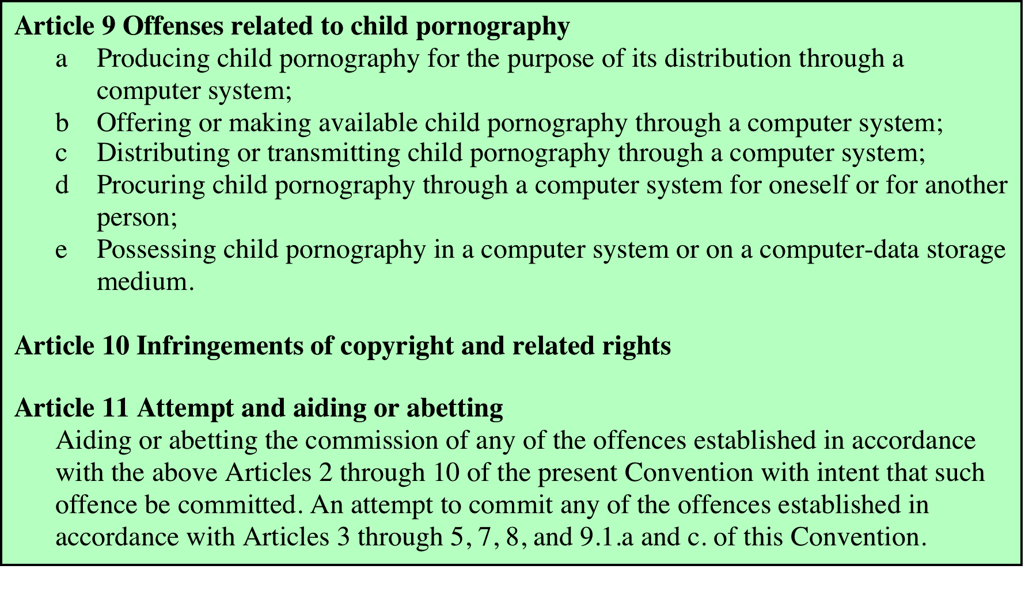
Table 19.1 - Cybercrimes Cited in the Convention on Cybercrime (page 2 of 2)
Notes:
Table 19.1 Cybercrimes Cited in the Convention on Cybercrime. Page 2 of 2.

Slide 6
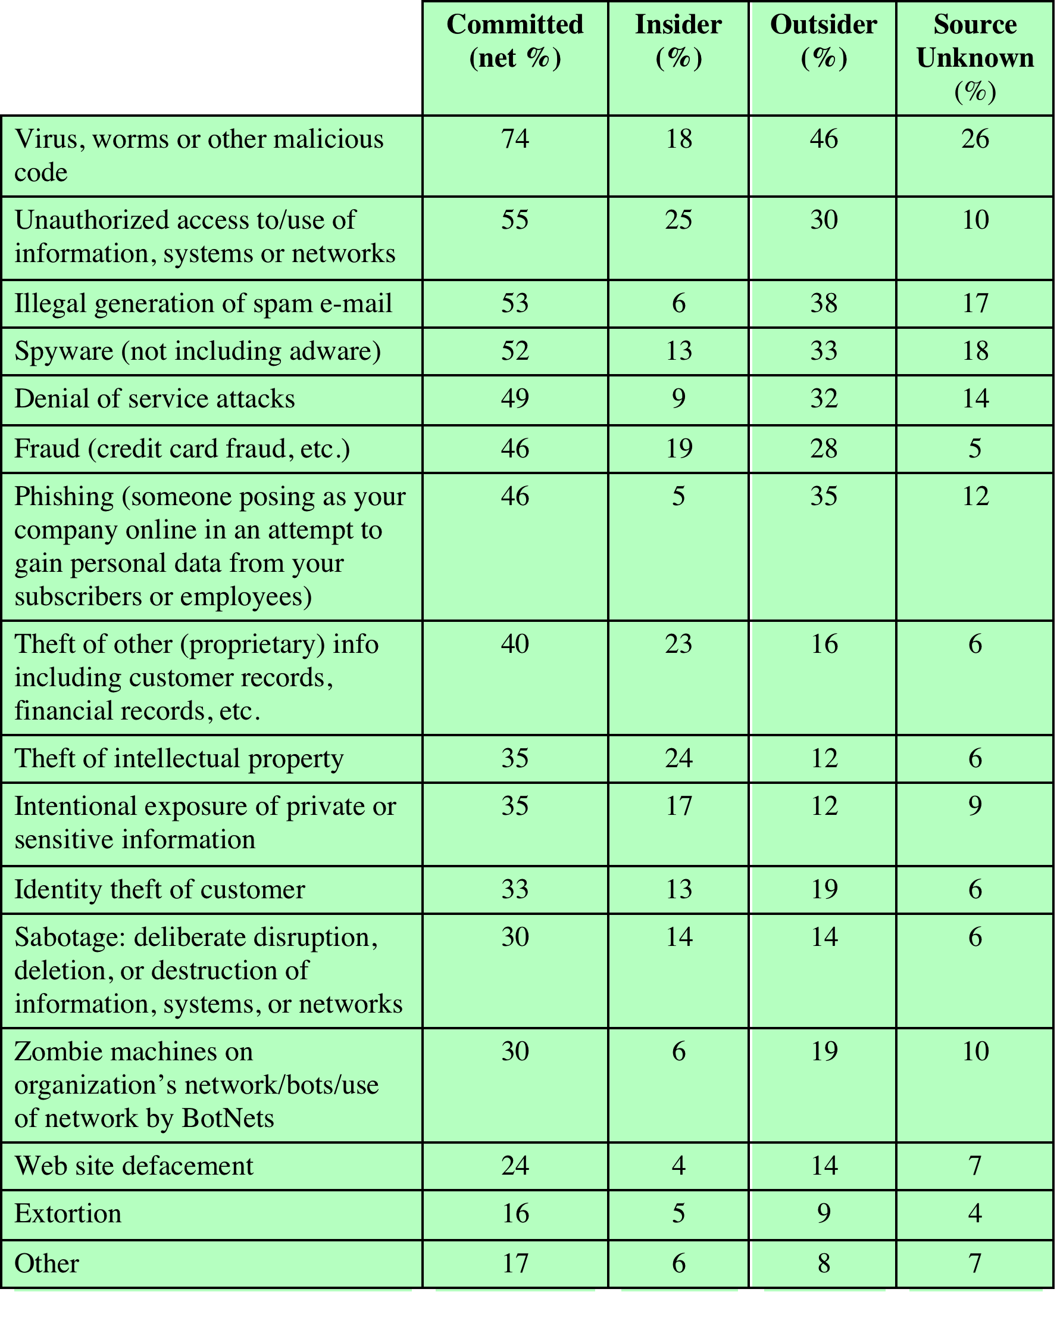
Table 19.2 CERT 2007 E-Crime Watch Survey Results
Notes:
Yet another categorization is used in the CERT 2007 E-crime Survey, the
results of which are shown in Table 19.2 . The figures in the second column indicate
the percentage of respondents who report at least one incident in the corresponding
row category. Entries in the remaining three columns indicate the percentage of
respondents who reported a given source for an attack.

Slide 7
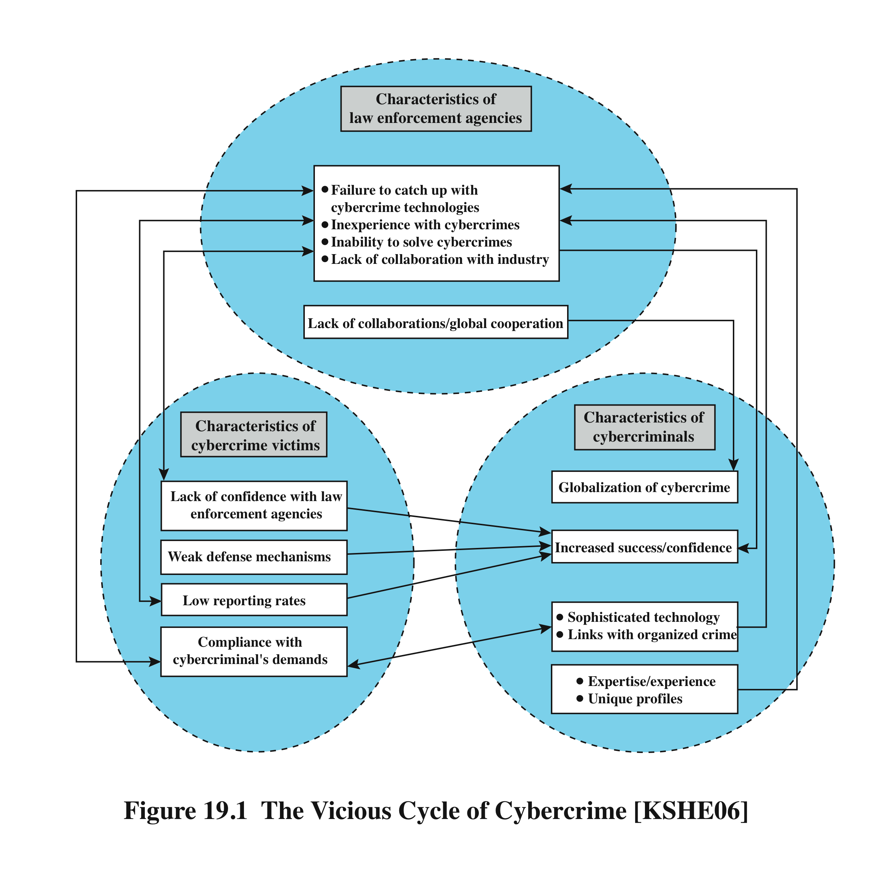
Law Enforcement Challenges
Notes:
The deterrent effect of law enforcement on computer and network attacks correlates
with the success rate of criminal arrest and prosecution. The nature of cybercrime
is such that consistent success is extraordinarily difficult. To see this, consider what
[KSHE06] refers to as the vicious cycle of cybercrime, involving law enforcement
agencies, cybercriminals, and cybercrime victims ( Figure 19.1 ).
For law enforcement agencies , cybercrime presents some unique difficulties.
Proper investigation requires a fairly sophisticated grasp of the technology.
Although some agencies, particularly larger agencies, are catching up in this
area, many jurisdictions lack investigators knowledgeable and experienced in
dealing with this kind of crime. Lack of resources represents another handicap.
Some cybercrime investigations require considerable computer processing
power, communications capacity, and storage capacity, which may be beyond the
budget of individual jurisdictions. The global nature of cybercrime is an additional
obstacle: Many crimes will involve perpetrators who are remote from the target
system, in another jurisdiction or even another country. A lack of collaboration and
cooperation with remote law enforcement agencies can greatly hinder an investigation.
Initiatives such as international Convention on Cybercrime are a promising
sign. The Convention at least introduces a common terminology for crimes and a
framework for harmonizing laws globally.
The relative lack of success in bringing cybercriminals to justice has led to an
increase in their numbers, boldness, and the global scale of their operations. It is
difficult to profile cybercriminals in the way that is often done with other types of
repeat offenders. The cybercriminal tends to be young and very computer-savvy,
but the range of behavioral characteristics is wide. Further, there exist no cybercriminal
databases that can point investigators to likely suspects.
The success of cybercriminals, and the relative lack of success of law enforcement,
influence the behavior of cybercrime victims . As with law enforcement, many
organizations that may be the target of attack have not invested sufficiently in technical,
physical, and human-factor resources to prevent attacks. Reporting rates tend to
be low because of a lack of confidence in law enforcement, a concern about corporate
reputation, and a concern about civil liability. The low reporting rates and the
reluctance to work with law enforcement on the part of victims feeds into the handicaps
under which law enforcement works, completing the vicious cycle.
Executive management and security administrators need to look upon law enforcement
as another resource and tool, alongside technical, physical, and human-factor
resources. The successful use of law enforcement depends much more on people
skills than technical skills. Management needs to understand the criminal investigation
process, the inputs that investigators need, and the ways in which the victim can
contribute positively to the investigation.

Slide 8
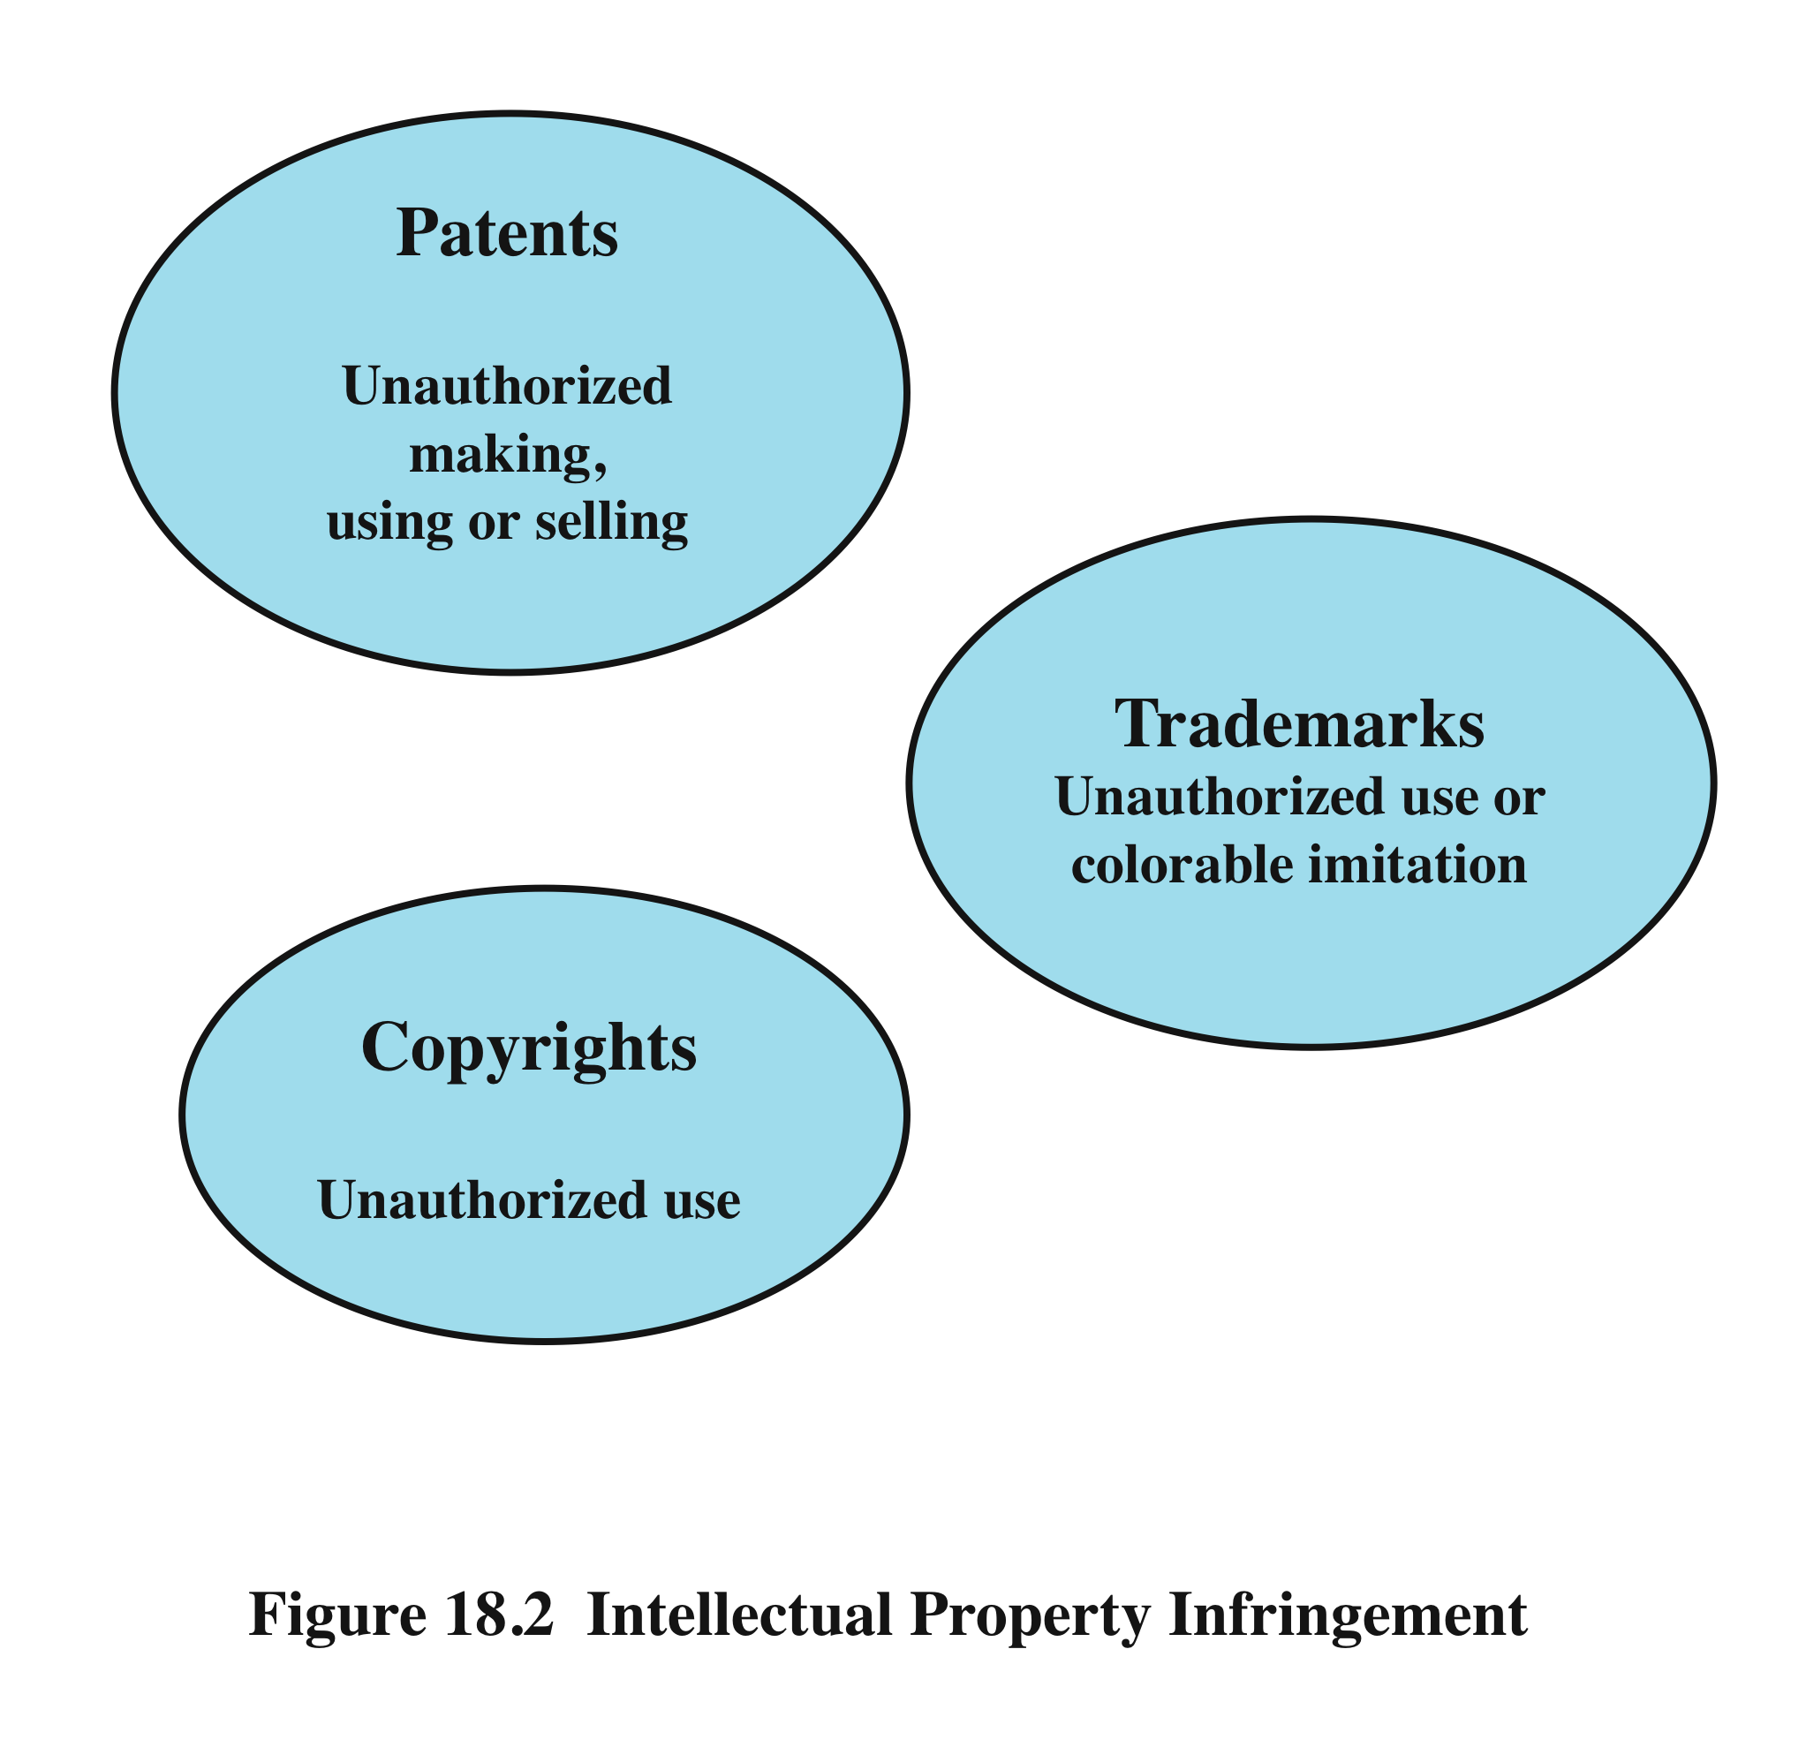
intellectual property is defined as “any intangible asset that consists of human knowledge and ideas”.
Intellectual Property
infringement is “the invasion of the rights secured by copyrights, trademarks, and patents”.
Notes:
• Intellectual property : Any intangible asset that consists of human knowledge
and ideas. Examples include software, data, novels, sound recordings, the design
of a new type of mousetrap, or a cure for a disease.
There are three main types of intellectual property for which legal protection is available:
copyrights, trademarks, and patents. The legal protection is against infringement ,
which is the invasion of the rights secured by copyrights, trademarks, and patents. The
right to seek civil recourse against anyone infringing his or her property is granted to
the IP owner. Depending upon the type of IP, infringement may vary ( Figure 19.2 ).

Slide 9
Copyright
protects tangible or fixed expression of an idea but not the idea itself
creator can claim and file copyright at a national government copyright office if:
proposed work is original
creator has put original idea in concrete form
Notes:
Copyright law protects the tangible or fixed expression of an idea,
not the idea itself. A creator can claim copyright, and file for the copyright at a
national government copyright office, if the following conditions are fulfilled:
• The proposed work is original.
• The creator has put this original idea into a concrete form, such as hard copy
(paper), software, or multimedia form.

Slide 10

Copyright Rights
copyright owner has these exclusive rights, protected against infringement:
reproduction right
modification right
distribution right
public-performance right
public-display right
examples of items that can be copyrighted include:
literary works
musical works
dramatic works
pantomimes and choreographic works
pictorial, graphic, and sculptural works
motion pictures and other audiovisual works
sound recordings
architectural works
software-related works
Notes:
The copyright owner has the following exclusive rights, protected against
infringement:
• Reproduction right: Lets the owner make copies of a work
• Modification right: Also known as the derivative-works right; concerns modifying
a work to create a new or derivative work
• Distribution right: Lets the owner publicly sell, rent, lease, or lend copies of the
work
• Public-performance right: Applies mainly to live performances
• Public-display right: Lets the owner publicly show a copy of the work directly
or by means of a film, slide, or television image
Examples of items that may be copyrighted include the following [BRAU01]:
• Literary works: Novels, nonfiction prose, poetry, newspaper articles and newspapers,
magazine articles and magazines, catalogs, brochures, ads (text), and
compilations such as business directories
• Musical works: Songs, advertising jingles, and instrumentals
• Dramatic works: Plays, operas, and skits
• Pantomimes and choreographic works: Ballets, modern dance, jazz dance, and
mime works
• Pictorial, graphic, and sculptural works: Photographs, posters, maps, paintings,
drawings, graphic art, display ads, cartoon strips and cartoon characters, stuffed
animals, statues, paintings, and works of fine art
• Motion pictures and other audiovisual works: Movies, documentaries, travelogues,
training films and videos, television shows, television ads, and interactive
multimedia works
• Sound recordings: Recordings of music, sound, or words
• Architectural works: Building designs, whether in the form of architectural
plans, drawings, or the constructed building itself
• Software-related works: Computer software, software documentation and
manuals, training manuals, other manuals

Slide 11
Patent
grant a property right to the inventor
“the right to exclude others from making, using, offering for sale, or selling” the invention in the United States or “importing” the invention into the United States
types:
utility
design
plant
any new and useful process, machine, article of manufacture, or composition of matter
new, original, and ornamental design for an article of manufacture
discovers and asexually reproduces any distinct and new variety of plant
Notes:
A patent for an invention is the grant of a property right to the inventor.
The right conferred by the patent grant is, in the language of the U.S. statute and
of the grant itself, “the right to exclude others from making, using, offering for sale,
or selling” the invention in the United States or “importing” the invention into the
United States. Similar wording appears in the statutes of other nations. There are
three types of patents:
• Utility patents: May be granted to anyone who invents or discovers any new
and useful process, machine, article of manufacture, or composition of matter,
or any new and useful improvement thereof;
• Design patents: May be granted to anyone who invents a new, original, and
ornamental design for an article of manufacture; and
• Plant patents: May be granted to anyone who invents or discovers and asexually
reproduces any distinct and new variety of plant.
An example of a patent from the computer security realm is the RSA public-key
cryptosystem. From the time it was granted in 1983 until the patent expired in 2000,
the patent holder, RSA Security, was entitled to receive a fee for each implementation
of RSA.

Slide 12
Trademark
a word, name, symbol, or device
used in trade with goods
indicates source of goods
distinguishes them from goods of others
trademark rights may be used to:
prevent others from using a confusingly similar mark
but not to prevent others from making the same goods or from selling the same goods or services under a clearly different mark
Notes:
A trademark is a word, name, symbol, or device that is used in trade
with goods to indicate the source of the goods and to distinguish them from the
goods of others. A servicemark is the same as a trademark except that it identifies
and distinguishes the source of a service rather than a product. The terms trademark
and mark are commonly used to refer to both trademarks and servicemarks.
Trademark rights may be used to prevent others from using a confusingly similar
mark, but not to prevent others from making the same goods or from selling the
same goods or services under a clearly different mark.

Slide 13
U.S. Digital Millennium Copyright ACT (DMCA)
signed into law in 1998
implements WIPO treaties to strengthen protections of digital copyrighted materials
encourages copyright owners to use technological measures to protect their copyrighted works
measures that prevent access to the work
measures that prevent copying of the work
prohibits attempts to bypass the measures
both criminal and civil penalties apply to attempts to circumvent
Notes:
The U.S. Digital Millennium Copyright Act (DMCA) has had a profound effect
on the protection of digital content rights in both the United States and worldwide.
The DMCA, signed into law in 1998, is designed to implement World Intellectual
Property Organization (WIPO) treaties, signed in 1996. In essence, DMCA
strengthens the protection of copyrighted materials in digital format.
The DMCA encourages copyright owners to use technological measures to
protect copyrighted works. These measures fall into two categories: measures that
prevent access to the work and measures that prevent copying of the work. Further,
the law prohibits attempts to bypass such measures. Specifically, the law states
that “no person shall circumvent a technological measure that effectively controls
access to a work protected under this title.” Among other effects of this clause, it
prohibits almost all unauthorized decryption of content. The law further prohibits
the manufacture, release, or sale of products, services, and devices that can crack
encryption designed to thwart either access to or copying of material unauthorized
by the copyright holder. Both criminal and civil penalties apply to attempts to
circumvent technological measures and to assist in such circumvention.

Slide 14
DMCA Exemptions
certain actions are exempted from the provisions of the DMCA and other copyright laws including:
considerable concern exists that DMCA inhibits legitimate security and encryption research
feel that innovation and academic freedom is stifled and open source software development is threatened
fair use
reverse engineering
encryption research
security testing
personal privacy
Notes:
Certain actions are exempted from the provisions of the DMCA and other
copyright laws, including the following:
• Fair use: This concept is not tightly defined. It is intended to permit others to
perform, show, quote, copy, and otherwise distribute portions of the work for
certain purposes. These purposes include review, comment, and discussion of
copyrighted works.
• Reverse engineering: Reverse engineering of a software product is allowed if
the user has the right to use a copy of the program and if the purpose of the
reverse engineering is not to duplicate the functionality of the program but
rather to achieve interoperability.
• Encryption research: “Good faith” encryption research is allowed. In essence,
this exemption allows decryption attempts to advance the development of
encryption technology.
• Security testing: This is the access of a computer or network for the good faith
testing, investigating, or correcting a security flaw or vulnerability, with the
authorization of the owner or operator.
• Personal privacy: It is generally permitted to bypass technological measures if
that is the only reasonable way to prevent the access to result in the revealing
or recording of personally identifying information.
Despite the exemptions built into the Act, there is considerable concern, especially
in the research and academic communities, that the act inhibits legitimate security
and encryption research. These parties feel that DMCA stifles innovation and
academic freedom and is a threat to open source software development [ACM04].

Slide 15
Digital Rights Management (DRM)
systems and procedures that ensure that holders of digital rights are clearly identified and receive stipulated payment for their works
may impose further restrictions such as inhibiting printing or prohibiting further distribution
no single DRM standard or architecture
objective is to provide mechanisms for the complete content management life cycle
provide persistent content protection for a variety of digital content types / platforms / media
Notes:
Digital Rights Management (DRM) refers to systems and procedures that ensure that
holders of digital rights are clearly identified and receive the stipulated payment for
their works. The systems and procedures may also impose further restrictions on the
use of digital objects, such as inhibiting printing or prohibiting further distribution.
There is no single DRM standard or architecture. DRM encompasses a variety
of approaches to intellectual property management and enforcement by providing
secure and trusted automated services to control the distribution and use of content.
In general, the objective is to provide mechanisms for the complete content management
life cycle (creation, subsequent contribution by others, access, distribution, use),
including the management of rights information associated with the content.
DRM systems should meet the following objectives:
1. Provide persistent content protection against unauthorized access to the
digital content, limiting access to only those with the proper authorization.
2. Support a variety of digital content types (e.g., music files, video streams, digital
books, images).
3. Support content use on a variety of platforms, (e.g., PCs, PDAs, iPods, mobile
phones).
4. Support content distribution on a variety of media, including CD-ROMs,
DVDs, and flash memory.

Slide 16
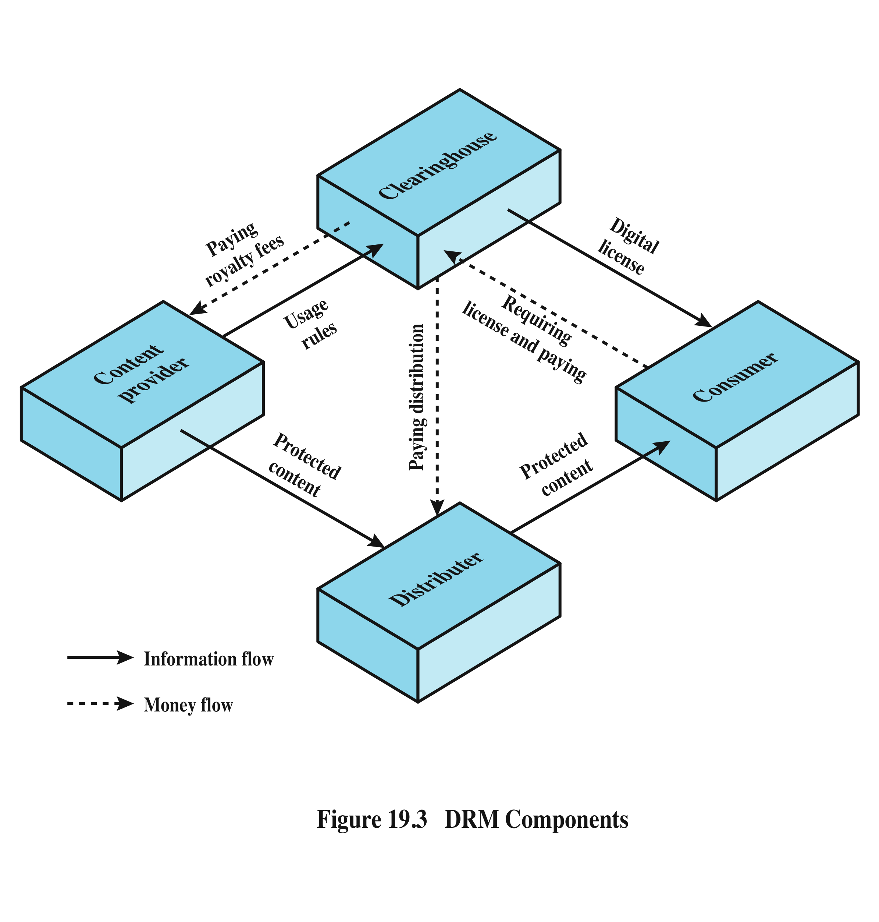
DRM Components
Notes:
Figure 19.3 , based on [LIU03], illustrates a typical DRM model in terms of the
principal users of DRM systems:
• Content provider: Holds the digital rights of the content and wants to protect
these rights. Examples are a music record label and a movie studio.
• Distributor: Provides distribution channels, such as an online shop or a Web
retailer. For example, an online distributor receives the digital content from
the content provider and creates a Web catalog presenting the content and
rights metadata for the content promotion.
• Consumer: Uses the system to access the digital content by retrieving downloadable
or streaming content through the distribution channel and then
paying for the digital license. The player/viewer application used by the
consumer takes charge of initiating license request to the clearinghouse and
enforcing the content usage rights.
• Clearinghouse: Handles the financial transaction for issuing the digital license
to the consumer and pays royalty fees to the content provider and distribution
fees to the distributor accordingly. The clearinghouse is also responsible for
logging license consumptions for every consumer.
In this model, the distributor need not enforce the access rights. Instead, the
content provider protects the content in such a way (typically encryption) that the
consumer must purchase a digital license and access capability from the clearinghouse.
The clearinghouse consults usage rules provided by the content provider to
determine what access is permitted and the fee for a particular type of access. Having
collected the fee, the clearinghouse credits the content provider and distributor
appropriately.

Slide 17
Privacy
overlaps with computer security
dramatic increase in scale of information collected and stored
motivated by law enforcement, national security, economic incentives
individuals have become increasingly aware of access and use of personal information and private details about their lives
concerns about extent of privacy compromise have led to a variety of legal and technical approaches to reinforcing privacy rights
Notes:
An issue with considerable overlap with computer security is that of privacy. On
one hand, the scale and interconnectedness of personal information collected and
stored in information systems has increased dramatically, motivated by law enforcement,
national security, and economic incentives. The last mentioned has been
perhaps the main driving force. In a global information economy, it is likely that the
most economically valuable electronic asset is aggregations of information on individuals
[HAYE09]. On the other hand, individuals have become increasingly aware
of the extent to which government agencies, businesses, and even Internet users have
access to their personal information and private details about their lives and activities.
Concerns about the extent to which personal privacy has been and may be
compromised have led to a variety of legal and technical approaches to reinforcing
privacy rights.

Slide 18
European Union (EU) Data Protection Directive
adopted in 1998 to:
ensure member states protect fundamental privacy rights when processing personal information
prevent member states from restricting the free flow of personal information within EU
organized around principles of:
notice
consent
consistency
access
security
onward transfer
enforcement
Notes:
A number of international organizations and national governments have introduced
laws and regulations intended to protect individual privacy. We look at two
such initiatives in this subsection.
In 1998, the EU adopted the
Directive on Data Protection to both (1) ensure that member states protected
fundamental privacy rights when processing personal information, and (2) prevent
member states from restricting the free flow of personal information within the
EU. The Directive is not itself a law, but requires member states to enact laws
encompassing its terms. The Directive is organized around the following principles
of personal information use:
• Notice: Organizations must notify individuals what personal information they
are collecting, the uses of that information, and what choices the individual
may have.
• Consent: Individuals must be able to choose whether and how their personal
information is used by, or disclosed to, third parties. They have the right
not to have any sensitive information collected or used without express
permission, including race, religion, health, union membership, beliefs, and
sex life.
• Consistency: Organizations may use personal information only in accordance
with the terms of the notice given the data subject and any choices with respect
to its use exercised by the subject.
• Access: Individuals must have the right and ability to access their information
and correct, modify, or delete any portion of it.
• Security: Organizations must provide adequate security, using technical and
other means, to protect the integrity and confidentiality of personal information.
• Onward transfer: Third parties receiving personal information must provide
the same level of privacy protection as the organization from whom the information
is obtained.
• Enforcement: The Directive grants a private right of action to data subjects
when organizations do not follow the law. In addition, each EU member has a
regulatory enforcement agency concerned with privacy rights enforcement.

Slide 19
United States Privacy Initiatives
Privacy Act of 1974
dealt with personal information collected and used by federal agencies
permits individuals to determine records kept
permits individuals to forbid records being used for other purposes
permits individuals to obtain access to records and to correct and amend records as appropriate
ensures agencies properly collect, maintain, and use personal information
creates a private right of action for individuals
(Also have a range of other privacy laws – many focus on medical records, children’s privacy, etc.)
Notes:
The first comprehensive privacy legislation
adopted in the United States was the Privacy Act of 1974, which dealt with personal
information collected and used by federal agencies. The Act is intended to
1. Permit individuals to determine what records pertaining to them are collected,
maintained, used, or disseminated.
2. Permit individuals to forbid records obtained for one purpose to be used for
another purpose without consent.
3. Permit individuals to obtain access to records pertaining to them and to correct
and amend such records as appropriate.
4. Ensure that agencies collect, maintain, and use personal information in a manner
that ensures that the information is current, adequate, relevant, and not
excessive for its intended use.
5. Create a private right of action for individuals whose personal information is
not used in accordance with the Act.
As with all privacy laws and regulations, there are exceptions and conditions
attached to this Act, such as criminal investigations, national security concerns, and
conflicts between competing individual rights of privacy.
While the 1974 Privacy Act covers government records, a number of other
U.S. laws have been enacted that cover other areas, including the following:
• Banking and financial records: Personal banking information is protected
in certain ways by a number of laws, including the recent Financial Services
Modernization Act.
• Credit reports: The Fair Credit Reporting Act confers certain rights on individuals
and obligations on credit reporting agencies.
• Medical and health insurance records: A variety of laws have been in place
for decades dealing with medical records privacy. The Health Insurance
Portability and Accountability Act (HIPPA) created significant new rights for
patients to protect and access their own health information.
• Children’s privacy: The Children’s Online Privacy Protection Act places
restrictions on online organizations in the collection of data from children
under the age of 13.
• Electronic communications: The Electronic Communications Privacy Act
generally prohibits unauthorized and intentional interception of wire an
electronic communications during the transmission phase and unauthorized
accessing of electronically stored wire and electronic communications.

Slide 20
ISO 27002 states . . .
“An organizational data protection and privacy policy
should be developed and implemented. This policy
should be communicated to all persons involved in the processing of personal information. Compliance with this policy and all relevant data protection legislation and regulations requires appropriate management structure and control. Often this is best achieved by the appointment of a person responsible, such as a data protection officer, who should provide guidance to managers, users, and service providers on their individual responsibilities and the specific procedures that should be followed. Responsibility for handling personal information and ensuring awareness of the data protection principles should be dealt with in accordance with relevant legislation and regulations. Appropriate technical and organizational measures to protect personal information should be implemented.”
Notes:
Organizations need to deploy both management controls and technical measures
to comply with laws and regulations concerning privacy as well as to implement
corporate policies concerning employee privacy. ISO 27002 ( Code of Practice for
Information Security Management ) states the requirement as follows:
ISO 27002: Data protection and privacy of personal information: An organizational
data protection and privacy policy should be developed and implemented.
This policy should be communicated to all persons involved in the processing of
personal information. Compliance with this policy and all relevant data protection
legislation and regulations requires appropriate management structure and
control. Often this is best achieved by the appointment of a responsible person,
such as a data protection officer, who should provide guidance to managers, users,
and service providers on their individual responsibilities and the specific procedures
that should be followed. Responsibility for handling personal information
and ensuring awareness of the data protection principles should be dealt with in
accordance with relevant legislation and regulations. Appropriate technical and
organizational measures to protect personal information should be implemented.
An excellent, detailed list of considerations for organizational implementation
of privacy controls is provided in The Standard of Good Practice for Information
Security , from the Information Security Forum [ISF11]. This material is reproduced
in Appendix H .4.

Slide 21
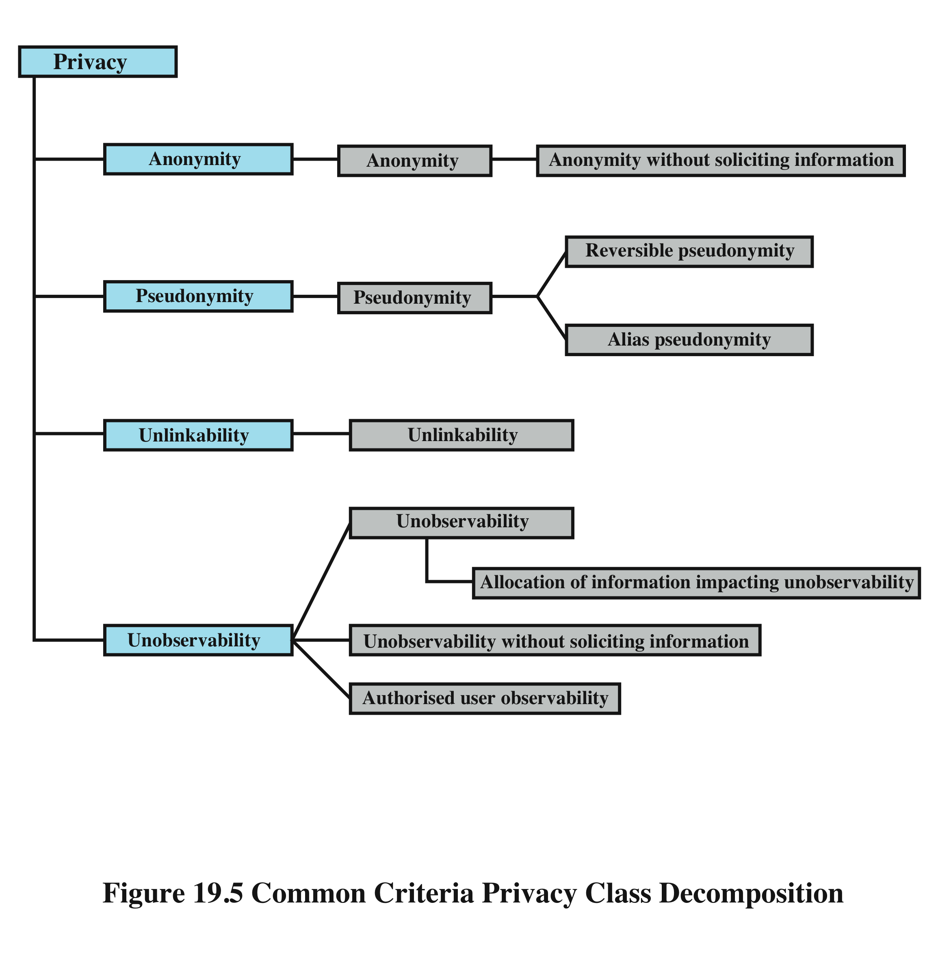
Common Criteria Privacy Class
Notes:
The Common Criteria specification [CCPS04b] includes a definition of a set of functional
requirements in a Privacy Class, which should be implemented in a trusted
system. The purpose of the privacy functions is to provide a user protection against
discovery and misuse of identity by other users. This specification is a useful guide
to how to design privacy support functions as part of a computer system. Figure 19.5
shows a breakdown of privacy into four major areas, each of which has one or more
specific functions:
• Anonymity: Ensures that a user may use a resource or service without
disclosing the user’s identity. Specifically, this means that other users or
subjects are unable to determine the identity of a user bound to a subject
(e.g., process or user group) or operation. It further means that the system
will not solicit the real name of a user. Anonymity need not conflict with
authorization and access control functions, which are bound to computer based
user IDs, not to personal user information.
• Pseudonymity: Ensures that a user may use a resource or service without
disclosing its user identity, but can still be accountable for that use. The system
shall provide an alias to prevent other users from determining a user’s
identity, but the system shall be able to determine the user’s identity from an
assigned alias.
• Unlinkability: Ensures that a user may make multiple uses of resources or
services without others being able to link these uses together.
• Unobservability: Ensures that a user may use a resource or service without
others, especially third parties, being able to observe that the resource or service
is being used. Unobservability requires that users and/or subjects cannot
determine whether an operation is being performed. Allocation of information
impacting unobservability requires that the security function provide
specific mechanisms to avoid the concentration of privacy related information
within the system. Unobservability without soliciting information requires that
the security function does not try to obtain privacy-related information that
might be used to compromise unobservability. Authorized user observability
requires the security function to provide one or more authorized users with a
capability to observe the usage of resources and/or services.
Note that the Common Criteria specification is primarily concerned with the privacy
of an individual with respect to that individual’s use of computer resources, rather
than the privacy of personal information concerning that individual.

Slide 22
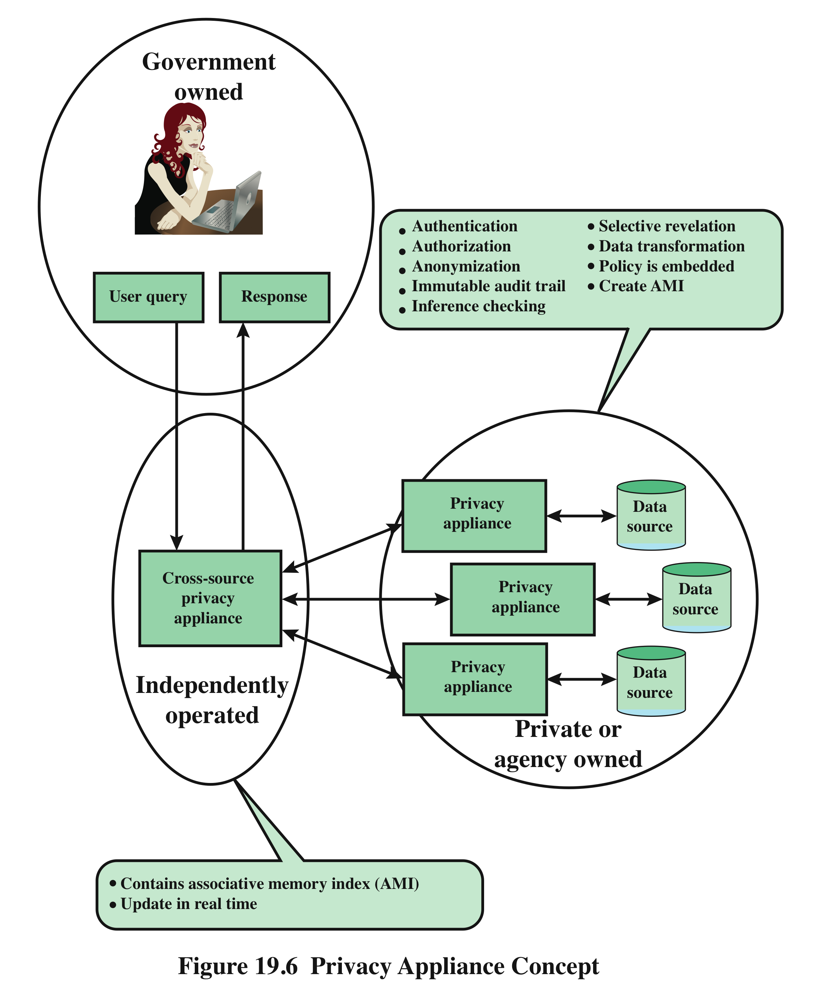
Privacy and Data Surveillance
Notes:
The demands of homeland security and counterterrorism have imposed new threats
to personal privacy. Law enforcement and intelligence agencies have become
increasingly aggressive in using data surveillance techniques to fulfill their mission.
In addition, private organizations are exploiting a number of trends to increase their
ability to build detailed profiles of individuals, including the spread of the Internet,
the increase in electronic payment methods, near-universal use of cellular phone
communications, ubiquitous computation, sensor webs, and so on.
Both policy and technical approaches are needed to protect privacy when both
government and nongovernment organizations seek to learn as much as possible
about individuals. In terms of technical approaches, the requirements for privacy
protection for information systems can be addressed in the context of database
security. That is, the approaches that are appropriate for privacy protection involve
technical means that have been developed for database security. These are discussed
in detail in Chapter 5 .
A specific proposal for a database security approach to privacy protection
is outlined in [POPP06] and illustrated in Figure 19.6 . The privacy appliance is a
tamper-resistant, cryptographically protected device that is interposed between a
database and the access interface, analogous to a firewall or intrusion prevention
device. The device implements privacy protection functions, including verifying the
user’s access permissions and credentials and creating an audit log. Some of the
specific functions of the appliance are as follows:
• Data transformation: This function encodes or encrypts portions of the data
so as to preserver privacy but still allow data analysis functions needed for
effective use. An example of such data analysis functions is the detection of
terrorist activity patterns.
• Anonymization: This function removes specific identifying information from
query results, such as last name and telephone number, but creates some
sort of anonymized unique identifier so that analysts can detect connections
between queries.
• Selective revelation: This is a method for minimizing exposure of individual
information while enabling continuous analysis of potentially interconnected
data. The function initially reveals information to the analyst only in sanitized
form, that is, in terms of statistics and categories that do not reveal (directly or
indirectly) anyone’s private information. If the analyst sees reason for concern,
he or she can follow up by seeking permission to get more precise information.
This permission would be granted if the initial information provides sufficient
cause to allow the revelation of more information, under appropriate legal
and policy guidelines.
• Immutable audit: A tamper-resistant method that identifies where data go
and who has seen the data. The audit function automatically and permanently
records all data accesses, with strong protection against deletion, modification,
and unauthorized use.
• Associative memory: This is a software module that can recognize patterns
and make connections between pieces of data that the human user may have
missed or didn’t know existed. With this method, it can discover relationships
quickly between data points found in massive amounts of data.
As Figure 19.6 indicates, the owner of a database installs a privacy appliance
tailored to the database content and structure and to its intended use by outside
organizations. An independently operated privacy appliance can interact with
multiple databases from multiple organizations to collect and interconnect data
for their ultimate use by law enforcement, an intelligence user, or other appropriate
user.

Slide 23
Ethical Issues
many potential misuses and abuses of information and electronic communication that create privacy and security problems
basic ethical principles developed by civilizations apply
unique considerations surrounding computers and information systems
scale of activities not possible before
creation of new types of entities for which no agreed ethical rules have previously been formed
ethics:
“a system of moral principles that relates to the benefits and harms of particular actions, and to the rightness and wrongness of motives and ends of those actions.”
Notes:
Because of the ubiquity and importance of information systems in organization of
all types, there are many potential misuses and abuses of information and electronic
communication that create privacy and security problems. In addition to questions
of legality, misuse and abuse raise concerns of ethics. Ethics refers to a system of
moral principles that relates to the benefits and harms of particular actions, and to
the rightness and wrongness of motives and ends of those actions. In this section,
we look at ethical issues as they relate to computer and information system security.
To a certain extent, a characterization of what constitutes ethical behavior for
those who work with or have access to information systems is not unique to this
context. The basic ethical principles developed by civilizations apply. However,
there are some unique considerations surrounding computers and information
systems. First, computer technology makes possible a scale of activities not
possible before. This includes a larger scale of recordkeeping, particularly on individuals,
with the ability to develop finer-grained personal information collection
and more precise data mining and data matching. The expanded scale of communications
and the expanded scale of interconnection brought about by the Internet
magnify the power of an individual to do harm. Second, computer technology has
involved the creation of new types of entities for which no agreed ethical rules
have previously been formed, such as databases, Web browsers, chat rooms, cookies,
and so on.

Slide 24
Ethical Issues Related to Computers and Information Systems
Some ethical issues from computer use [PARK88]:
repositories and processors of information
producers of new forms and types of assets
instruments of acts
symbols of intimidation and deception
Many times an ethical issue in the context of a digital environment is not so clear. Examples?
Notes:
Let us turn now more specifically to the ethical issues that arise from computer
technology. Computers have become the primary repository of both personal information
and negotiable assets, such as bank records, securities records, and other
financial information. Other types of databases, both statistical and otherwise, are
assets with considerable value. These assets can only be viewed, created, and altered
by technical and automated means. Those who can understand and exploit the
technology, plus those who have obtained access permission, have power related to
those assets.
A classic paper on computers and ethics [PARK88] points out that ethical
issues arise as the result of the roles of computers, such as the following:
• Repositories and processors of information: Unauthorized use of otherwise
unused computer services or of information stored in computers raises questions
of appropriateness or fairness.
• Producers of new forms and types of assets: For example, computer programs
are entirely new types of assets, possibly not subject to the same concepts of
ownership as other assets.
• Instruments of acts: To what degree must computer services and users of computers,
data, and programs be responsible for the integrity and appropriateness
of computer output?
• Symbols of intimidation and deception: The images of computers as thinking
machines, absolute truth producers, infallible, subject to blame, and as anthropomorphic
replacements of humans who err should be carefully considered.

Slide 25
Ethical Question Examples
whistle-blower
when professional ethical duty conflicts with loyalty to employer
e.g. inadequately tested software product
organizations and professional societies should provide alternative mechanisms
fair use
what rights can be assumed when a consumer purchases a digital piece of content
no clear analogy with non-digital content
Notes:
We cite two areas here of the types of ethical questions
that face a computing or IS professional. The first is that IS professionals may
find themselves in situations where their ethical duty as professionals comes into
conflict with loyalty to their employer. Such a conflict may give rise for an employee
to consider “blowing the whistle,” or exposing a situation that can harm the public
or a company’s customers. For example, a software developer may know that a
product is scheduled to ship with inadequate testing to meet the employer’s deadlines.
The decision of whether to blow the whistle is one of the most difficult that
an IS professional can face. Organizations have a duty to provide alternative, less
extreme opportunities for the employee, such as an in-house ombudsperson coupled
with a commitment not to penalize employees for exposing problems in-house.
Additionally, professional societies should provide a mechanism whereby society
members can get advice on how to proceed.
Another example of an ethical question concerns a potential conflict of interest.
For example, if a consultant has a financial interest in a certain vendor, this
should be revealed to any client if that vendor’s products or services might be recommended
by the consultant.

Slide 26
Codes of Conduct
ethics are not precise laws or sets of facts
many areas may present ethical ambiguity
many professional societies have adopted ethical codes of conduct which aim to:
1
2
provide a measure of support
be a means of deterrence and discipline
enhance the profession's public image
be a positive stimulus and instill confidence
be educational
3
4
5
Notes:
Unlike scientific and engineering fields, ethics cannot be reduced to precise laws
or sets of facts. Although an employer or a client of a professional can expect that
the professional has an internal moral compass, many areas of conduct may present
ethical ambiguities. To provide guidance to professionals and to articulate what
employers and customers have a right to expect, a number of professional societies
have adopted ethical codes of conduct.
A professional code of conduct can serve the following functions [GOTT99]:
1. A code can serve two inspirational functions: as a positive stimulus for ethical
conduct on the part of the professional, and to instill confidence in the customer
or user of an IS product or service. However, a code that stops at just
providing inspirational language is likely to be vague and open to an abundance
of interpretations.
2. A code can be educational. It informs professionals about what should be their
commitment to undertake a certain level of quality of work and their responsibility
for the well-being of users of their product and the public, to the extent
the product may affect nonusers. The code also serves to educate managers on
their responsibility to encourage and support employee ethical behavior and
on their own ethical responsibilities.
3. A code provides a measure of support for a professional whose decision to act
ethically in a situation may create conflict with an employer or customer.
4. A code can be a means of deterrence and discipline. A professional society
can use a code as a justification for revoking membership or even a professional
license. An employee can use a code as a basis for a disciplinary action.
5. A code can enhance the profession’s public image, if it is seen to be widely
honored.

Slide 27
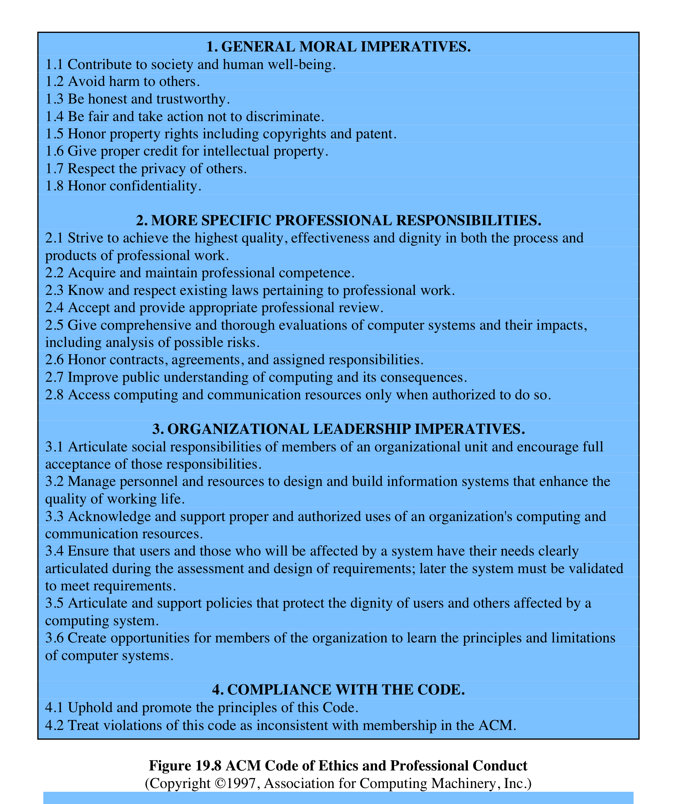
ACM Code of Ethics and Professional Conduct
Notes:
We illustrate the concept of a professional code of ethics for computer professionals
with three specific examples. The ACM (Association for Computing
Machinery) Code of Ethics and Professional Conduct ( Figure 19.8 ) applies to
computer scientists

Slide 28
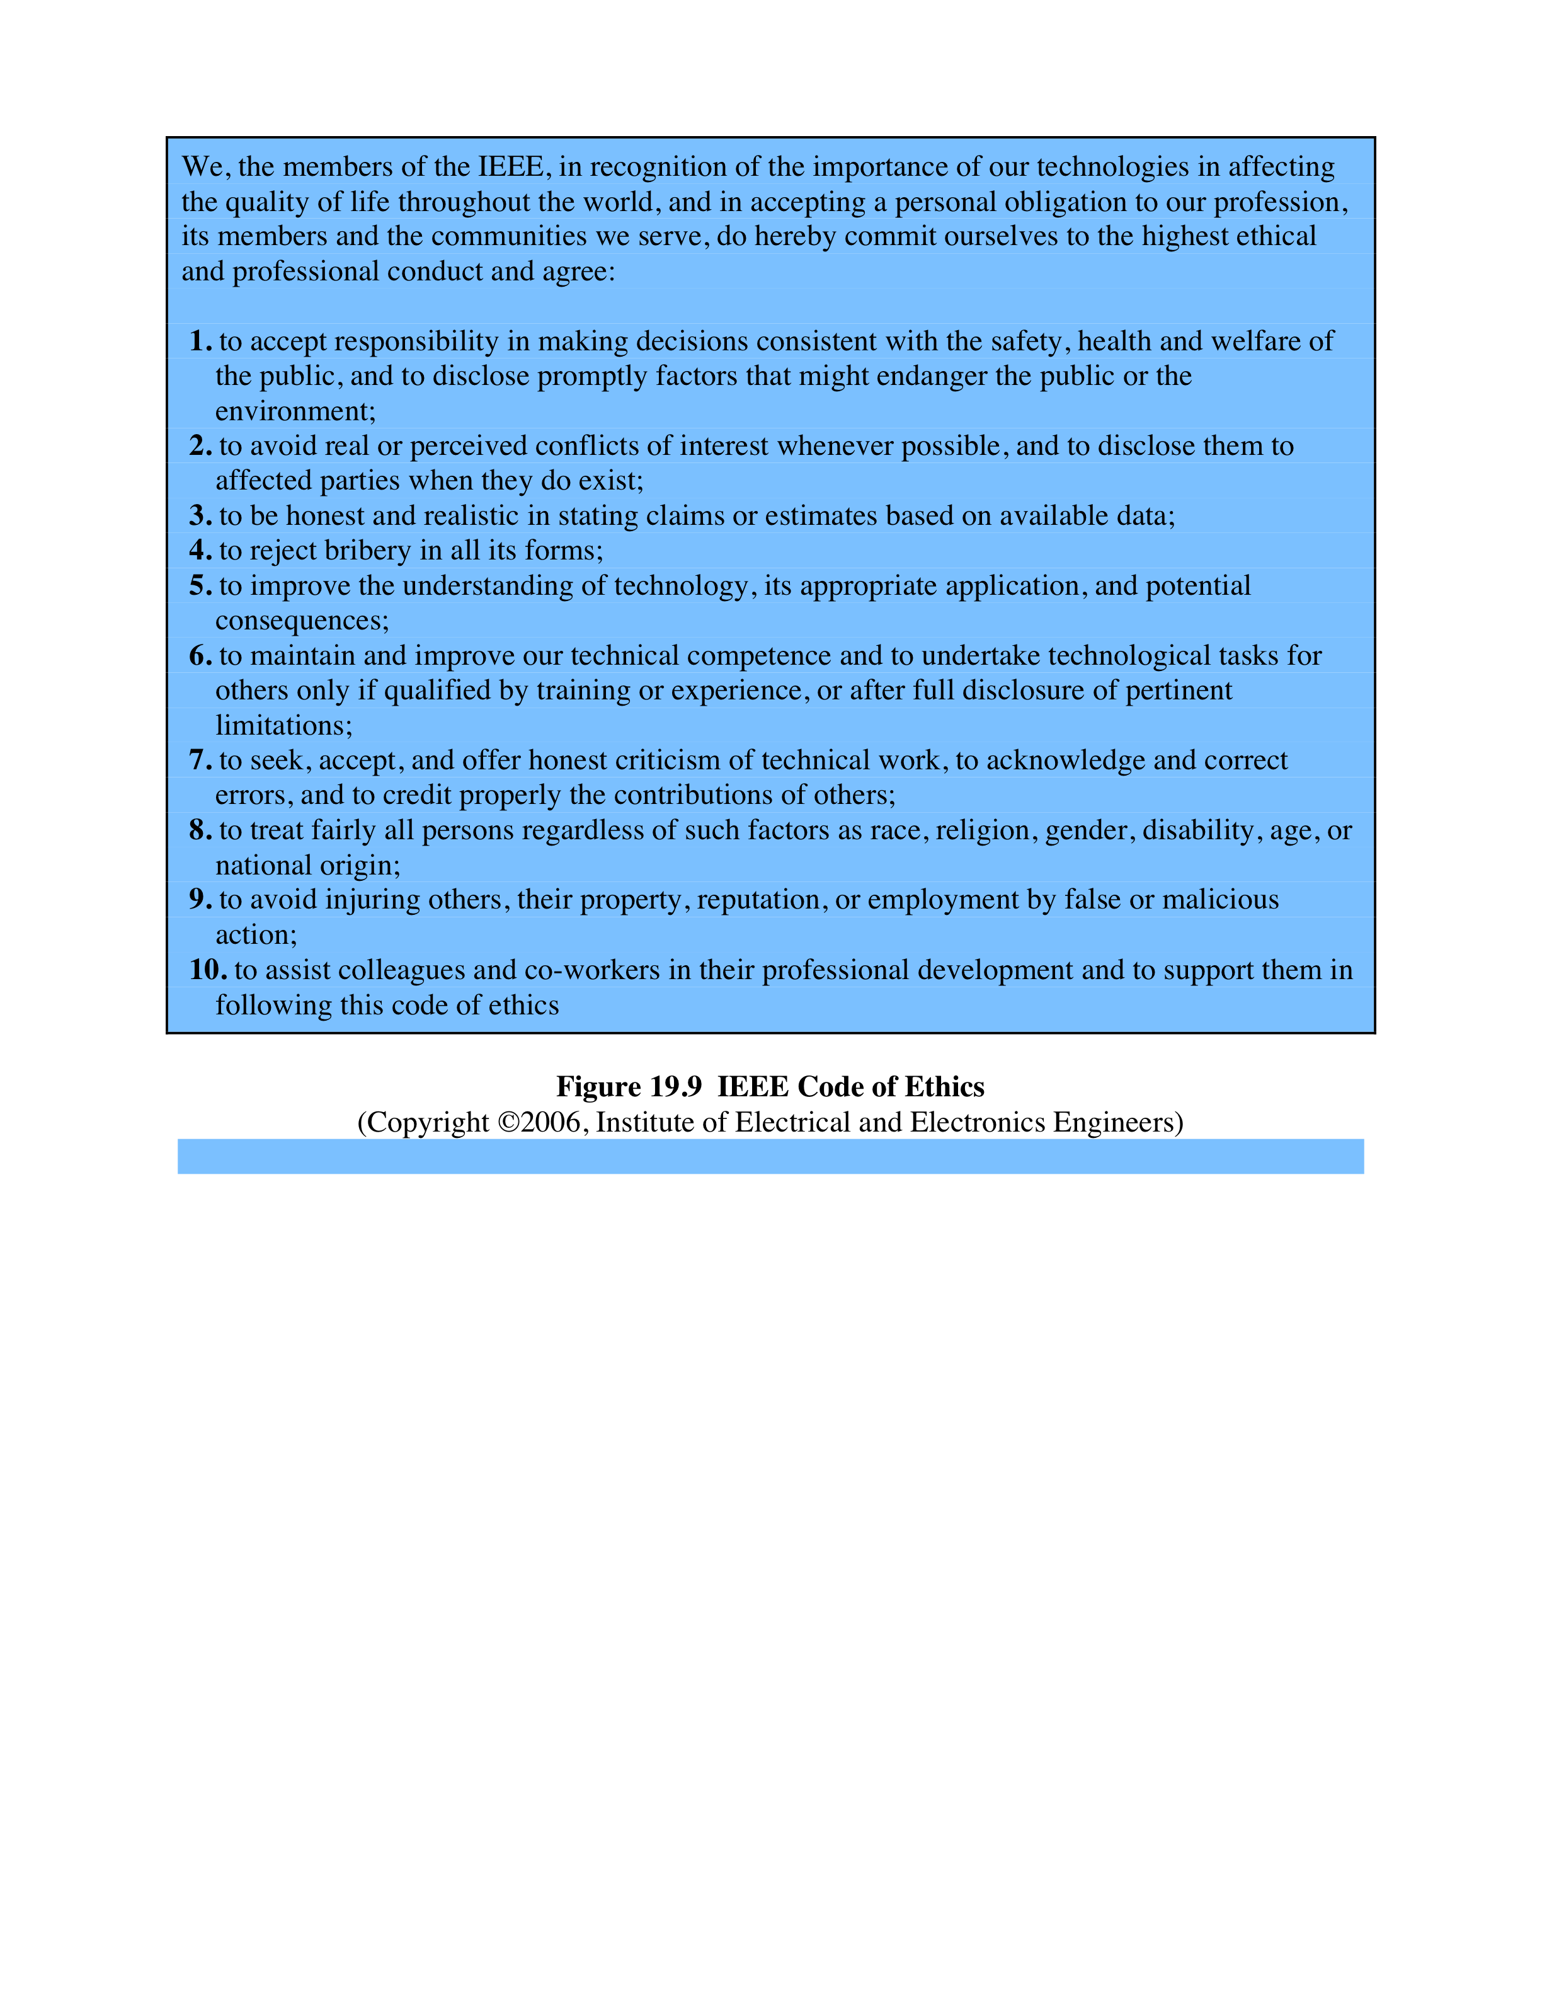
IEEE Code of Ethics
Notes:
The IEEE (Institute of Electrical and Electronic Engineers)
Code of Ethics ( Figure 19.9 ) applies to computer engineers as well as other types
of electrical and electronic engineers.

Slide 29
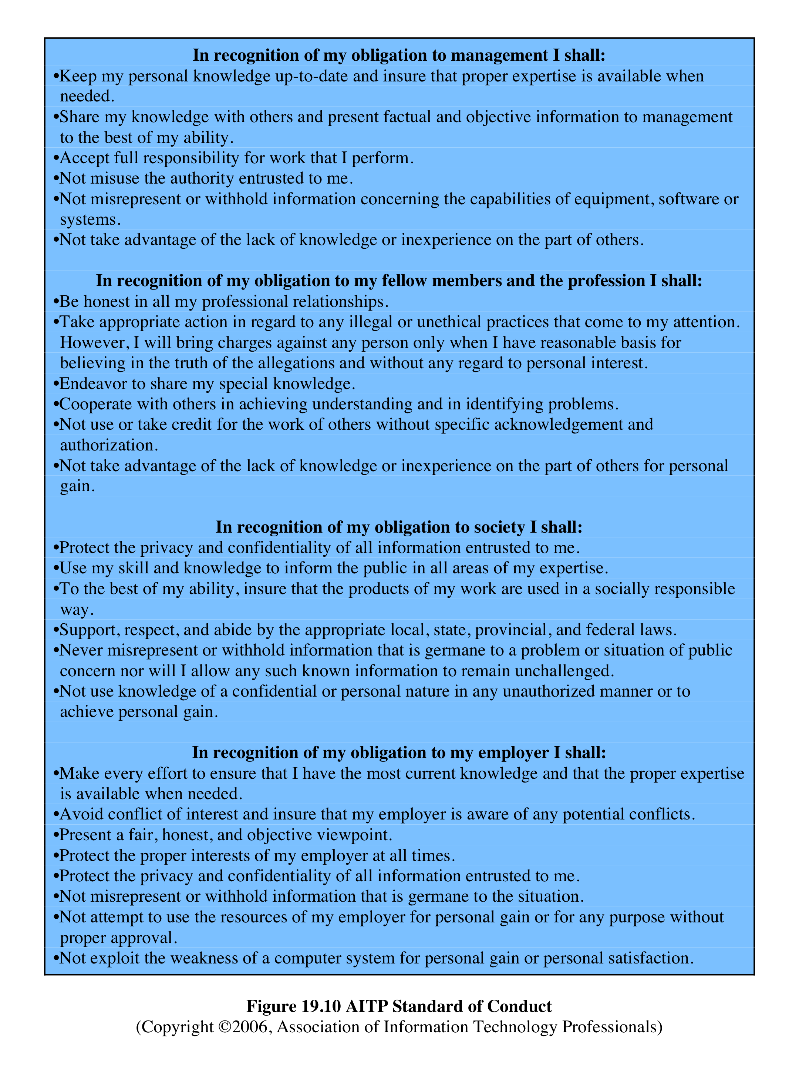
AITP Standard of Conduct
Notes:
The AITP (Association of Information
Technology Professionals, formerly the Data Processing Management
Association) Standard of Conduct ( Figure 19.10 ) applies to managers of computer
systems and projects.

Slide 30
Comparison of Codes of Conduct
all three codes place their emphasis on the responsibility of professionals to other people
do not fully reflect the unique ethical problems related to the development and use of computer and IS technology
common themes:
dignity and worth of other people
personal integrity and honesty
responsibility for work
confidentiality of information
public safety, health, and welfare
participation in professional societies to improve standards of the profession
the notion that public knowledge and access to technology is equivalent to social power
Notes:
A number of common themes emerge from these codes, including (1) dignity
and worth of other people; (2) personal integrity and honesty; (3) responsibility
for work; (4) confidentiality of information; (5) public safety, health, and welfare;
(6) participation in professional societies to improve standards of the profession;
and (7) the notion that public knowledge and access to technology is equivalent to
social power.

Slide 31
The Rules
collaborative effort to develop a short list of guidelines on the ethics of computer systems
Ad Hoc Committee on Responsible Computing
anyone can join this committee and suggest changes to the guidelines
Moral Responsibility for Computing Artifacts
generally referred to as The Rules
The Rules apply to software that is commercial, free, open source, recreational, an academic exercise or a research tool
computing artifact
any artifact that includes an executing computer program
Notes:
A different approach from the ones so far discussed is a collaborative effort to
develop a short list of guidelines on the ethics of developing computer systems. The
guidelines, which continue to evolve, are the product of the Ad Hoc Committee on
Responsible Computing. Anyone can join this committee and suggest changes to
the guidelines. The committee has publish a document, regularly updated, entitled
Moral Responsibility for Computing Artifacts , and is generally referred to as The
Rules . The current version of The Rules is version 27, reflecting the thought and
effort that has gone into this project.
The term computing artifact refers to any artifact that includes an executing
computer program. This includes software applications running on a general
purpose computer, programs burned into hardware and embedded in mechanical
devices, robots, phones, web bots, toys, programs distributed across more than one
machine, and many other configurations. The Rules apply to, among other types:
software that is commercial, free, open source, recreational, an academic exercise or
a research tool.

Slide 32
As of this writing, the rules are as follows:
The people who design, develop, or deploy a computing artifact are morally responsible for that artifact, and for the foreseeable effects of that artifact. This responsibility is shared with other people who design, develop, deploy or knowingly use the artifact as part of a sociotechnical system.
The shared responsibility of computing artifacts is not a zero-sum game. The responsibility of an individual is not reduced simply because more people become involved in designing, developing, deploying, or using the artifact. Instead, a person’s responsibility includes being answerable for the behaviors of the artifact and for the artifact’s effects after deployment, to the degree to which these effects are reasonably foreseeable by that person.
People who knowingly use a particular computing artifact are morally responsible for that use.
People who knowingly design, develop, deploy, or use a computing artifact can do so responsibly only when they make a reasonable effort to take into account the sociotechnical systems in which the artifact is embedded.
People who design, develop, deploy, promote, or evaluate a computing artifact should not explicitly or implicitly deceive users about the artifact or its foreseeable effects, or about the sociotechnical systems in which the artifact is embedded.
Notes:
As of this writing, the rules are as follows:
1. The people who design, develop, or deploy a computing artifact are morally
responsible for that artifact, and for the foreseeable effects of that artifact.
This responsibility is shared with other people who design, develop, deploy or
knowingly use the artifact as part of a sociotechnical system.
2. The shared responsibility of computing artifacts is not a zero-sum game. The
responsibility of an individual is not reduced simply because more people
become involved in designing, developing, deploying, or using the artifact.
Instead, a person’s responsibility includes being answerable for the behaviors
of the artifact and for the artifact’s effects after deployment, to the degree to
which these effects are reasonably foreseeable by that person.
3. People who knowingly use a particular computing artifact are morally responsible
for that use.
4. People who knowingly design, develop, deploy, or use a computing artifact
can do so responsibly only when they make a reasonable effort to take into
account the sociotechnical systems in which the artifact is embedded.
5. People who design, develop, deploy, promote, or evaluate a computing artifact
should not explicitly or implicitly deceive users about the artifact or its foreseeable
effects, or about the sociotechnical systems in which the artifact is embedded.
Compared to the codes of ethics discussed earlier, The Rules are few in
number and quite general in nature. They are intended to apply to a broad spectrum
of people involved in computer system design and development. The Rules have
gathered broad support as useful guidelines by academics, practitioners, computer
scientists, and philosophers from a number of countries [MILL11]. It seems likely
that The Rules will influence future versions of codes of ethics by computer-related
professional organizations.

